Slide 1
Lazy Incremental Computation for Efficient Scene Graph Rendering
Michael Wörister, Harald Steinlechner, Stefan Maierhofer, and Robert F. Tobler
VRVis Research Center Vienna, Austria

Slide 2
(Hierarchical) Scenes modelled Scene Graphs
Regular scene graph rendering algorithm can become inefficient
for large number of nodes / paths
Profiling shows: much time spent with traversal overhead
matrix multiplications
virtual function calls
...
→ scene graph traversal becomes performance bottleneck

Slide 3


Scene graph Optimizations
t₁
t₂
t₃
Sorting Packing Batching Instancing
t₃

Slide 4
Optimizations affect Model/Design
Optimizations leaks into application
Mutation of modeling datastructure ruins clean semantic view of the scene
Interaction of optimization with dynamic scenes
Some optimizations not valid in general (blending)
Expensive geometry/texture packing
How to combine with dynamic scenes?
CONFLICT

Slide 5


Separate Model/Optimization
Retain original datastructure
Additional optimization datastructure
t₁
t₂
t₃
Opt

Slide 6
Separate Model/Optimization
Retain original datastructure
Additional optimization datastructure
SET COL₁
SET LOC₂
SET
DRAW
SET LOC₁
SET
DRAW
SET COL₂
SET LOC₃
SET
DRAW
t₁
t₂
t₃

Slide 7
Separate Model/Optimization
Retain original datastructure
Additional optimization datastructure
SET COL₁
SET LOC₂
SET
DRAW
SET LOC₁
SET
DRAW
SET COL₂
SET LOC₃
SET
DRAW
t₁
t₂
t₃
Instruction-Array

Slide 8
Separate Model/Optimization
Retain original datastructure
Additional optimization datastructure
SET COL₁
SET LOC₂
SET
DRAW
SET LOC₁
SET
DRAW
SET COL₂
SET LOC₃
SET
DRAW
GPU-Resources
t₁
t₂
t₃

Slide 9
Separate Model/Optimization
Retain original datastructure
Additional optimization datastructure
SET COL₁
SET LOC₂
SET
DRAW
SET LOC₁
SET
DRAW
SET COL₂
SET LOC₃
SET
DRAW
t₁
t₂
t₃
Keep optimization datastructure in sync!

Slide 10
Efficient Synchronization
Changes in Scene graph
Modification to the tree or attributes
Change propagation in:
In-place updates / Structural updates
In this work: fast In-place updates

Slide 11
Efficient Synchronization
Changes in Scene graph
Modification to the tree or attributes
Change propagation in:
In-place updates / Structural updates
In this work: fast In-place updates

Slide 12
Efficient Synchronization
Changes in Scene graph
Modification to the tree or attributes
Change propagation in:
In-place updates / Structural updates
In this work: fast In-place updates
Today

Slide 13
Incremental Computation
Scenegraph
Optimize
Cache
Changes
Update

Slide 14
Incremental Computation
Scenegraph
Optimize
Cache
Changes
Update
Given input x and f(x), find changes of f(x) given changes in x
Originally used for Attribute Evaluation for Attribute Grammars
Builds on static dependency Graph

Slide 15
Dependency Graphs
Dependency Graphs used in
Build systems (like make)
Compilers (Data/Flow dependencies)
Visual programming (like Hypergraph, Hypershade)
Input
Comp
Input
Comp
r₁
Comp
Input

Slide 16
The Implied Dependency Graph
Geometry node → Leaf node
Dependency in Sg → Dependency Node
Computation → Dependency Node

Slide 17
Towards lazy attribute evaluation
Standard Optimal Algorithm [Reps et al. 1983] not suitable
Scene graphs are DAGs, parts may be culled
Demand driven approach by [Hudson 1991]
Cache

Slide 18
Towards lazy attribute evaluation
Step 1: Dependency triggers, perform out of date marking
Out of date!
Cache

Slide 19
Towards lazy attribute evaluation
Step 1: Dependency triggers, perform out of date marking
Out of date!
Cache

Slide 20
Towards lazy attribute evaluation
Step 1: Dependency triggers, perform out of date marking
Step 2: Update required values (recompute nodes which are out of date)
Out of date!
Cache

Slide 21
Towards lazy attribute evaluation
Step 1: Dependency triggers, perform out of date marking
Step 2: Update required values (recompute nodes which are out of date)
Cache

Slide 22
Towards lazy attribute evaluation
Step 1: Dependency triggers, perform out of date marking
Step 2: Update required values (recompute nodes which are out of date)
Step 3: Render
Cache

Slide 23
Not yet there: marking is eager
Large parts not visible
Marking not necessary/feasable
Replace eager marking with lazy polling
Keep list of transitive reachable Dependencies
Check for all predicates directly at cache entry
{ d₁, d₂, .. d_{n} }
r₁

Slide 24
Building an incremental Render Cache
Create cache entry for instruction parameters (in graphics memory)
C

Slide 25
Building an incremental Render Cache
Create instructions that draw the current leaf node
C

Slide 26
Building an incremental Render Cache
Create Dependency Metadata entry for cache entry
Based on type, this entry knows how to update the cache entry using remembered scenegraph nodes
M
C

Slide 27
Building an incremental Render Cache
Create Dependency Index for fast queries of cache entries affected by change
DEPENDENCY INDEX
M
M
M
C
C
C
Render Cache

Slide 28
Solid Foundation for Optimizations
For static scenes
State Sorting
Removal of redundant instructions
„Super Instructions“
Generalized Draw Sorting
For dynamic scenes
Parallel Cache Update
Memoized Transformation Matrices

Slide 29
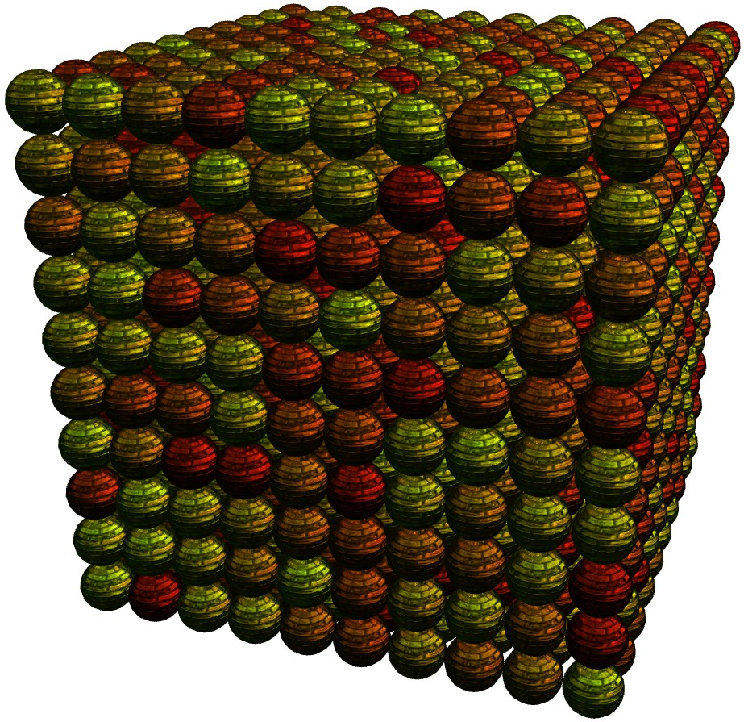
Evaluation: Worst case
Simulate worst case
Distinct buffers, distinct draw calls
Different shaders, materials etc.
Many, many draw calls
Draw call reduction not sufficient (culling)
Everything is visible
Huge dependency graph
GPU load static (poly counts)

Slide 30
Static Scenes

Slide 31
Optimizations: Factor 2.5

Slide 32
CPU Optimizations: Huge improvement

Slide 33
What are the costs?
Test scene with 22k objects, 224MB memory, 669MB graphics memory
Additional 3MB main memory (dependencies) + additional 3MB graphics memory for caching (buffers)

Slide 34
OpenSceneGraph Comparison

Slide 35
Dynamic Scene Setup
Octree structure
2 trafo nodes each level
depth: 5, some leafs empty
Percentage of dynamic objects
randomized, some trafos dynamic
varying from 0 – 100 percent changing trafo nodes

Slide 36
Dynamic Scenes

Slide 37
Future Work
Achieved: efficient rendering of high level scene graph
Structural scene graph changes
add/remove/change arbitrary nodes
caches need to built from scratch for this type
improve/generalize incremental model
Improved runtime system
optimization at runtime / on demand
automatic placement of render caches

Slide 38
Thanks to…
…my colleagues at the VRVis Research Center, especially:
Georg Haaser
Michael Schwärzler
Christian Luksch

Slide 39
Thank you for your attention!
Please visit us at
http://www.VRVis.at/

